Slide 1
House Price Prediction using machine learning
B.Tech F.Y.
DIV:Q Batch:1 Group:2
Group Members: Guide: Mrs.Puja Cholke 06_Pratham Sharma
07_Rituraj Sharma
08_Shafaque Shaikh
09_Prem Shejole
10_Dhiraj Shelke

Slide 2
OUTLINE
Introduction
Literature review
problem statement
Objectives
Algorithm
Flowchart
Architecture
Advantages and Disadvantages
Results and discussion
Conclusion and Future Scope
References

Slide 3
Introduction
It is a ML based effective house price prediction Project.
It predicts the house price by analysing the dataset which contains price of houses according to different parameters.
In this project we can analyse the price of houses using the graphs.

Slide 4
Literature review
Sr.No. | Name of Author | Title of Paper | Year | Output | Published
1 | ALAN IHRE AND ISAK ENGSTORM | Predicting house prices with machine learning method | 2019 | Splitting ,training and testing of datset | IEEE
2 | Bindu Sivasankar,Arun P.Ashok,Gouri Madhu,Fousiya S. | House Price Prediction Using | 2020 | Algorithm | IEEE
3 | Anand Rawool, Dattatray Rogye,Sainath Rane,Dr.Vinayak Bharadi | House Price Prediction With Machine Learning | 2021 | methodology | IEEE

Slide 5
problem statement
To Figure out best possible way to get an estimate for the user for house price

Slide 6
objectives
To make an effective price prediction model.
To identify the house price using different parameters like area, population in that area etc.
To predict accurate price of house.

Slide 7
implementation
We are using python and its libraries.
We are adding dataset for predicting the price of houses.
Libraries which we are using for our project are as follow:
Pandas : data analysis
NumPy : mathematical Operation
Matplotlib: graph plotting of dataset
Seaborn: statistical data visualization

Slide 8
Algorithm
Import libraries.
Adding of dataset.
Exploratory data analysis.
Dealing with a missing values.
Remove outliers.
Data Loading and Preprocessing.
Splitting data into the training and testing.
linear regression model.
Determine the prediction of house price.

Slide 9
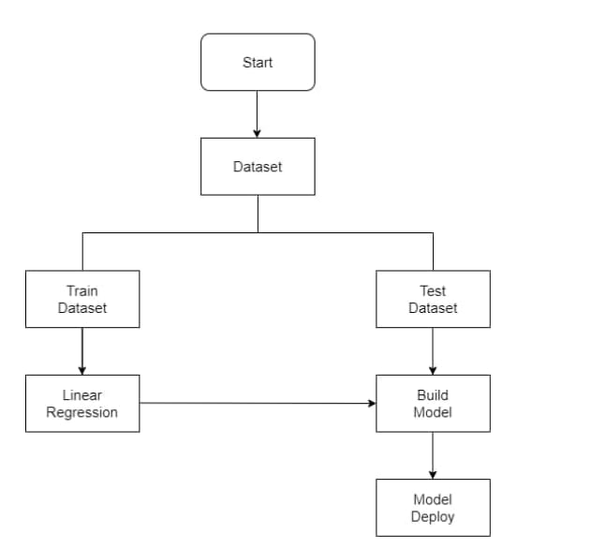
Flowchart

Slide 10
Architecture
Import the libraries
Add the dataset
Data Pre-Processing
Evaluation
Linear regression
Train and test Dataset

Slide 11
Advantages
With the help of this model user can analyse the price graphically.
it helps us to get idea how the house prices vary with each parameter.
Disadvantage
Our model have accuracy 87% so our model is not too accurate.
This model is limited for one city only.

Slide 12
Results and discussion
Our aim is to get most effective price for house, based on various attributes.
Based on our dataset we get the different types of graphs which help us analysing house price.

Slide 13
Conclusion and Future Scope
we constructed an algorithm based on Linear regression method to predict house prices on the basis of different parameters and To also train and test the parameters of this Linear regression model. We apply dataset for predicting house price. It helps the people to buy houses in budget.
In future, we will create the datasets for different cities from that we will be able to predict the house prices of that cities.

Slide 14
Contribution
Example
Div B Batch B1
Roll No 6-GRNo-1211264-Pratham Sharma
logic building and coding
Roll No 7-GRNo-12111256-Rituraj Sharma
logic building and coding
Roll No 8-GRNo-12110980-shafaque shaikh
Research paper, Collection of Dataset
Roll No 9-GRNo-12111049-Prem Shejole
- ideation, Collection of Dataset and coding
Roll No 5-GRNo-12110584-Dhiraj Shelke
Research paper

Slide 15
References
Calhoun C. A., (2003), “Property Valuation Models and House Price Indexes for The Provinces of Thailand: 1992 2000”, Housing Finance International, 17(3): 31 – 41.
Visit Limsombunchai, Christopher Gan and Minsoo Lee,“House Price Prediction: Hedonic Price Model vs. Artificial Neural Network”, American Journal of Applied Sciences 1 (3):193-201, 2004, ISSN 1546-9239, 193 – 201.
Housing Price Prediction An Nguyen March 20, 2018

Slide 16
Thank You!

